Slide 1
Network Layer in Internet
Prof. Ramesh Ragala

Slide 2
Network Layer
Internet can be viewed as collection of sub-networks or Autonomous System.
it provides best efforts to transport layer with out regarding whether the destination in same network or not.
it uses IP protocol.

Slide 3
IP Protocol
Format of IP datagram.
why we are called datagram?
Datagram → header part + data part
the header part → fixed part + variable part (optional)
fixed part has 20 bytes.
it is transmitted in Big Indian Format → left to right

Slide 4
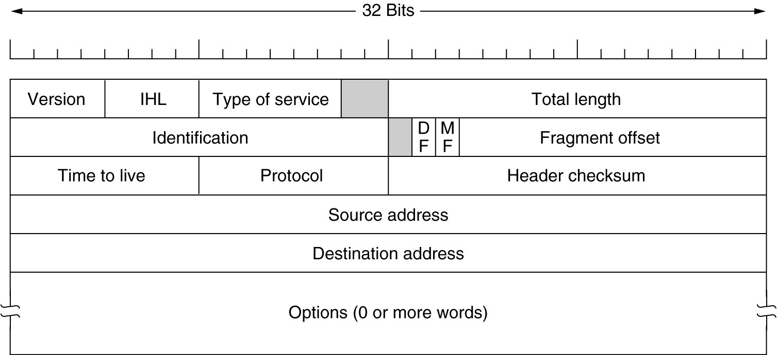
The IP Protocol –Header format
The IPv4 (Internet Protocol) header.

Slide 5
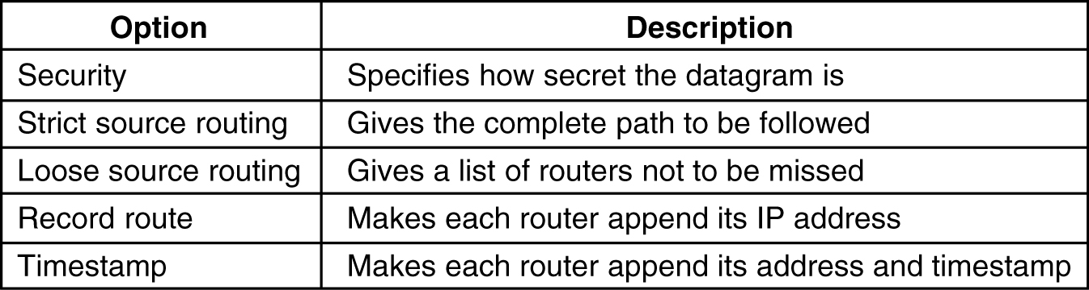
The IP Protocol – header format
Some of the IP options.
5-54

Slide 6
IP address
IP address are used to address the host in network.
It is unique global address for a network to identify the host and router.
it contains 2 parts
Host prefix / host portion →to specify the n/w
Network prefix / network portion → specifies the host in n/w
IPv4 contains 32 bit long where as IPv6 has 128 bit long.
It provides 2 services
Host or network interface identification
Locating the host
Network bits
Host bits

Slide 7
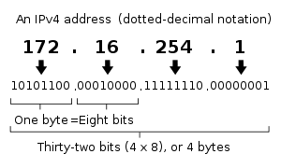
Dotted Decimal Notation
Machines read the IP address as a stream of 32 bits.
The 32-bit address is divided into 4 groups of 8 bits (octet)
Each octet is written as a decimal no. ranging from 0 to 255.
The decimal numbers are separated by periods, or dots.

Slide 8
Subnet mask
The network portion of the address is separated from the host portion of the address by a mask.
it indicating how many bits are used for network portion, by leaving the remaining bits as zero.
24 bit mask /24 → 24 bits are used for network and remaining 8 bits as host portion.

Slide 9
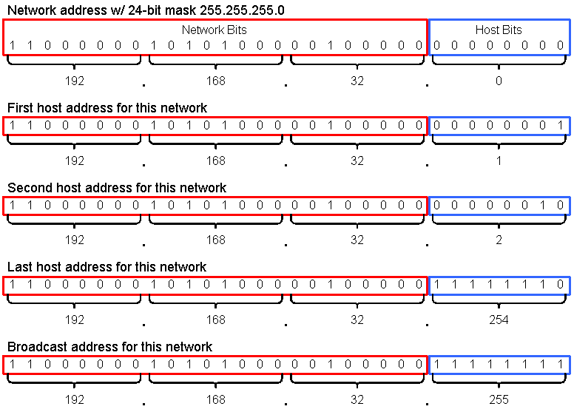
Subnet mask

Slide 10
IP address classification
IP address are classified into 5 categories
Class – A address
Class – B address
Class – C address
Class – D address
Class – E address
This is also called Classful addressing.
Private IP addresses → private organization
Public IP addresses → ICANN,ISP’s

Slide 11
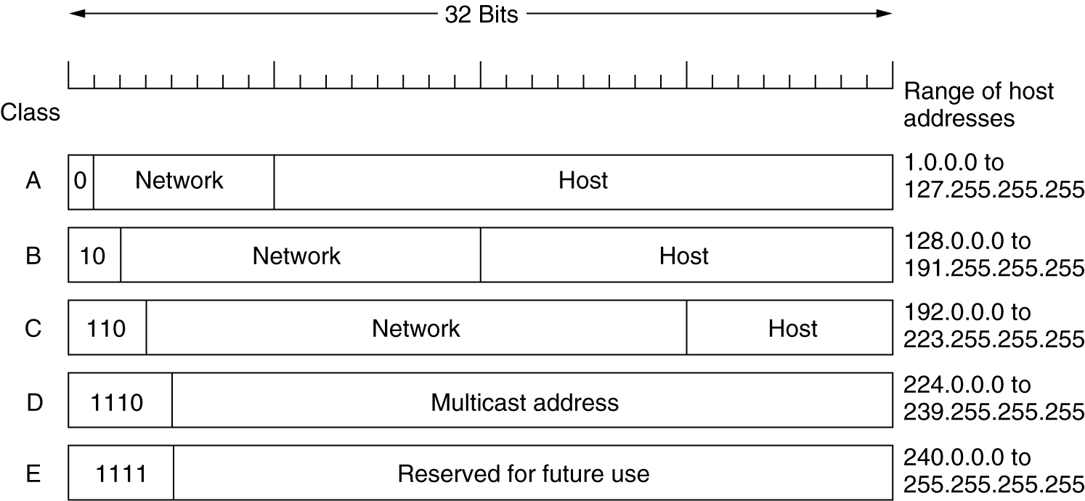
IP Addresses
IP address formats.

Slide 12
IP address
Class A Networks
First octet values range from 1 through 126
First octet starts with bit 0
Network mask is 8 bits , written /8 or 255.0.0.0.
1.0.0.0 through 126.0.0.0 are class A networks with 16777214hosts each.
Class B Networks
First octet values range from 128 through 197
First octet starts with bit pattern 10
Network mask is 16 bits , written /16 or 255.255.0.0.
128.0.0.0 through 191.255.0.0 are class B networks with 65523 hosts each.

Slide 13
IP address
Class C Networks
First octet values range from 192 through 223
First octet starts with bit 110
Network mask is 24 bits , written /24 or 255.255.255.0.
192.0.0.0 through 222.255.255.0 are class C networks with 254 hosts each.
Class D Networks
First octet values range from 224 through 239
First octet starts with bit pattern 1110
Class D address are multicast address.

Slide 14
IP address
0.0.0.0 is a default address, used to specify the default router only.
this 0.0.0.0 address is used by hosts when they are booting. → current n/w
Broadcast address: put all 1’s in host portion → broadcasting in destination network
If you put all 1’s in network and host portion, it pass that packet in all networks.
address beginning with 127 are reserved for internal loopback address.
Class A and B networks very large.
Improve the efficiency of IP addressing.
Subnet mask
variable length sub net masks
Classless interdomain routing.

Slide 15
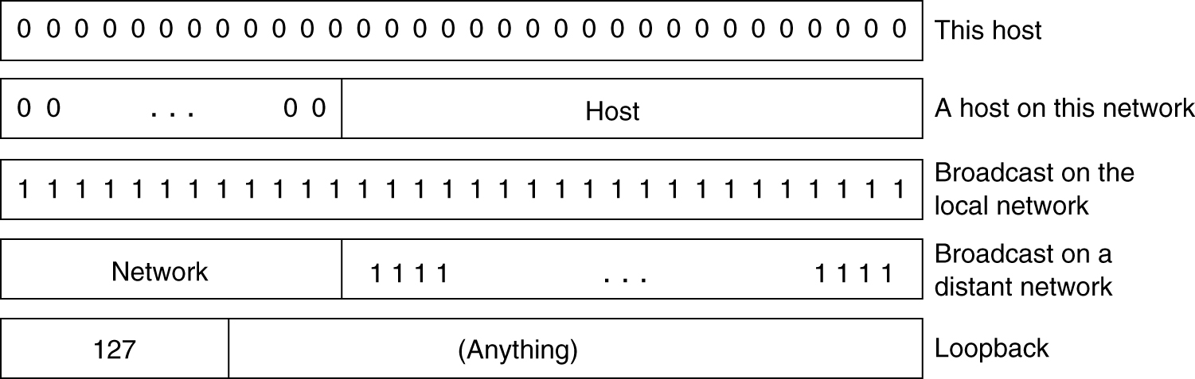
IP Addresses (2)
Special IP addresses.

Slide 16
subnet
Subnet masks are used to
Creates small networks
Manage small networks efficiently.
Each router identifying the small sub net by using sub net mask.
the subnet mask borrows some bits from host portion. Due to that we have many network with limited number of hosts.
So IP address have three part → n/w portion + subnet+ host portion.

Slide 17
Subnetting example
Take class A network 10.0.0.0 with network mask 255.0.0.0
barrow additional 8 subnet bits to network mask.
New subnet mask is 255.255.0.0
New subnets are 10.0.0.0, 10.1.0.0, 10.2.0.0, and so on with 65534 host addresses per subnet. Still too many hosts per subnet
router uses AND operation between the packet address with subnet mask to identify the subnetwork.

Slide 18
Private and Public IP address
Private IP address
Class A → 10.0.0.0 through 10.255.255.255
Class B → 169.254.0.0 through 169.254.255.255
Class C → 172.16.0.0 through 172.31.255.255
Class D → 192.168.0.0 through 192.168.255.255

Slide 19
CIDR (Classless Internet Domain Routing )
Internet is growing very rapidly. → out of IP address
Example IOT devices → Connect-ability → IP shortage
Many of IP address are wasting. Problem with Class A & B.
Class A has more addresses where as Class-C has very few host address. → not adequate to organizations.
This problem is called Three bearer Problem.
In reality, a class B address is far too large for most organizations. → going for Class C → wasting of IP
sol: split had allocated 20 bits to the class B n/w
problem → routing @ router → more routing tables.

Slide 20
CIDR (Classless Internet Domain Routing )
One best solution is CIDR.
Define in RFC 1519.
It allocates the remaining IP address in variable- sizes blocks, with out regarding class.
Example : organization needs → 2000 IP address
it assigns → 2048 IP address.
it is also creating problems while forwarding packets. → because we dropped the classes concepts

Slide 21
CIDR (Classless Internet Domain Routing )
Process @ router in classful scenario’s
Packet arrived @ Router, copy of the IP address shifted right 28 bits to yield a 4 bit class number.
A 16-way branch then sorted packets into A, B, C, and D (if supported), with eight of the cases for class A, four of the cases for class B, two of the cases for class C, and one each for D and E.
The code for each class then masked off the 8-, 16-, or 24-bit network number and right aligned it in a 32-bit word.
The network number was then looked up in the A, B, or C table, usually by indexing for A and B networks and hashing for C networks.

Slide 22
CIDR (Classless Internet Domain Routing )
In CIDR this algorithm will not work.
Each routing table entry is extended by giving it a 32-bit mask
So single routing table for all n/w consisting of an array of (IP address, Subnet mask, outgoing link) triples
When a packet comes in, its destination IP address is first extracted.
Comparison takes place on entry by entry.
It is possible that, multiple entries with different subnet mask length. In that case it takes the longest mask. Forward on the link. → this is problem.

Slide 23
CIDR (Classless Internet Domain Routing )
In CIDR this algorithm will not work.
Each routing table entry is extended by giving it a 32-bit mask
So single routing table for all n/w consisting of an array of (IP address, Subnet mask, outgoing link) triples
When a packet comes in, its destination IP address is first extracted.
Comparison takes place on entry by entry.
It is possible that, multiple entries with different subnet mask length. In that case it takes the longest mask. Forward on the link. → this is problem.

Slide 24
Continued
RARP
ICMP
DHCP
ARP
BOOTP
Used in Network Layer in Internet

Slide 25
ICMP (Internet Control Message Protocol)
The operation of the Internet is monitored closely by the routers.
Used to communicate IP status and error messages between host and routers
When something unexpected occurs during packet processing at a router, the event is reported to the sender by the ICMP.
ICMP is also used to test the Internet.
More than dozen types of ICMP messages are defined
Each ICMP message type is carried encapsulated in an IP packet.
Uses IP to route its messages between hosts

Slide 26
ICMP Message types
0 - Echo Reply
3 - Destination Unreachable
4 - Source Quench
5 - Redirect
8 - Echo
11 - Time Exceeded
12 - Parameter Problem
13 - Timestamp
14 - Timestamp Reply
15 - Information Request
16 - Information Reply
17 - Address Mask Request
18 - Address Mask Reply

Slide 27
ICMP (Internet Control Message Protocol)
DESTINATION UNREACHABLE: this message is used when the router cannot locate the destination or when a packet with the DF bit cannot be delivered because a ‘‘small-packet’’ network stands in the way.
TIME EXCEEDED : This message is sent when a packet is dropped because its TtL (Time to live) counter has reached zero.
traceroute utility: It finds the routers along the path from the host to a destination IP address.
PARAMETER PROBLEM: this message indicates that an illegal value has been detected in a header field.

Slide 28
ICMP (Internet Control Message Protocol)
SOURCE QUENCH: When a host received this message, it was expected to slow down.
REDIRECT: This message is used when a router notices that a packet seems to be routed incorrectly.
ECHO and ECHO REPLY: These messages are sent by hosts to see if a given destination is reachable and currently alive. Upon receiving the ECHO message, the destination is expected to send back an ECHO REPLY message. → used in ping
TIMESTAMP REQUEST and TIMESTAMP REPLY: these messages are similar, except that the arrival time of the message and the departure time of the reply are recorded in the reply.
ROUTER ADVERTISEMENT and ROUTER SOLICITATION: These messages are used to let hosts find nearby routers.

Slide 29
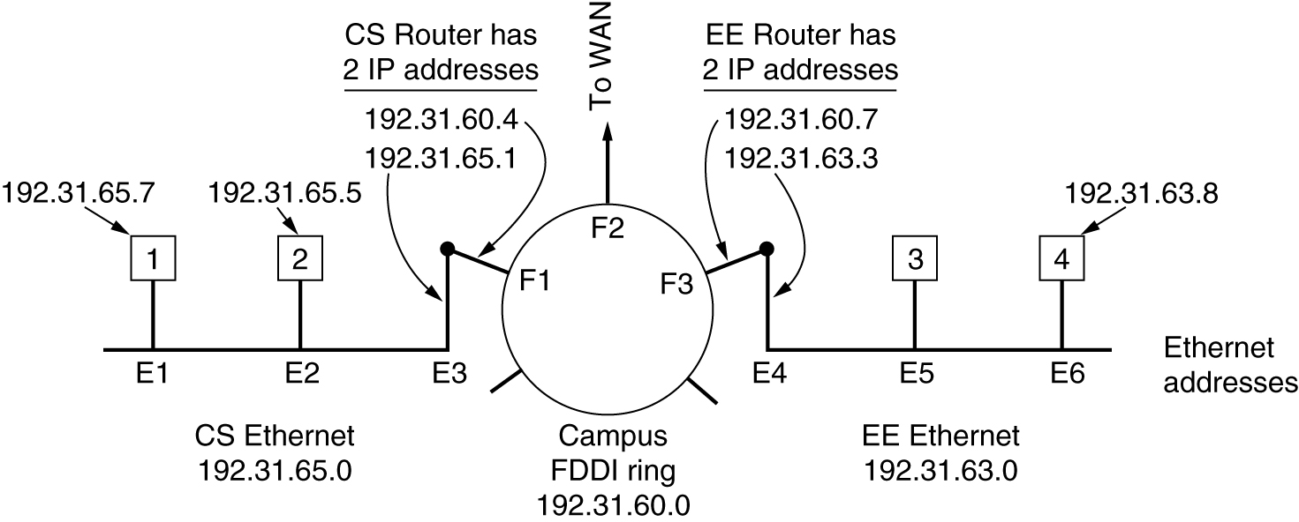
ARP – RFC 826

Slide 30
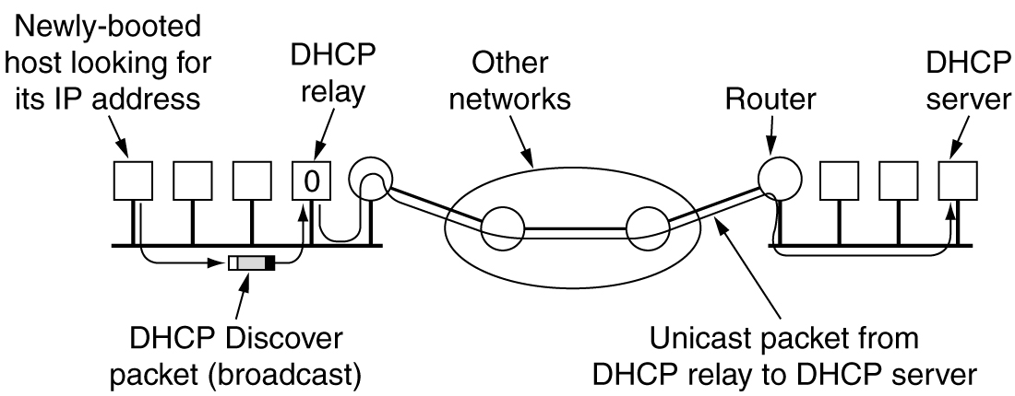
DHCP –

